Slide 1
Main Goal
Predicting genres and expected ratings from book covers

Slide 2
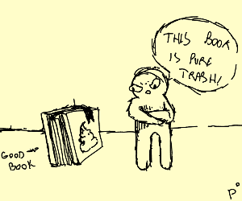
Motivation
Employ machine learning to explore the relationship between visual design and consumer preferences
Investigate relationship between books and their covers
Uncover visual features for designers to make more informed design choices

Slide 3
Previous work
Movie genre classification using plot summaries: Hoang, et al.
Learning and copying unique artistic styles: Gatys, et al.
Classifying paintings by artistic genres: Zujovic, et al.

Slide 4
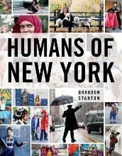
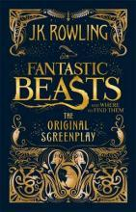




Dataset Overview
Attributes
image
name
author
format
book_depository_stars
price
currency
old_price
isbn
category
img_path
Kaggle dataset for 33 genre categories of books web scraped from bookdepository.com
Posters downloaded as thumbnails from the website to save memory and computation time
1000+ books in each category

Slide 5
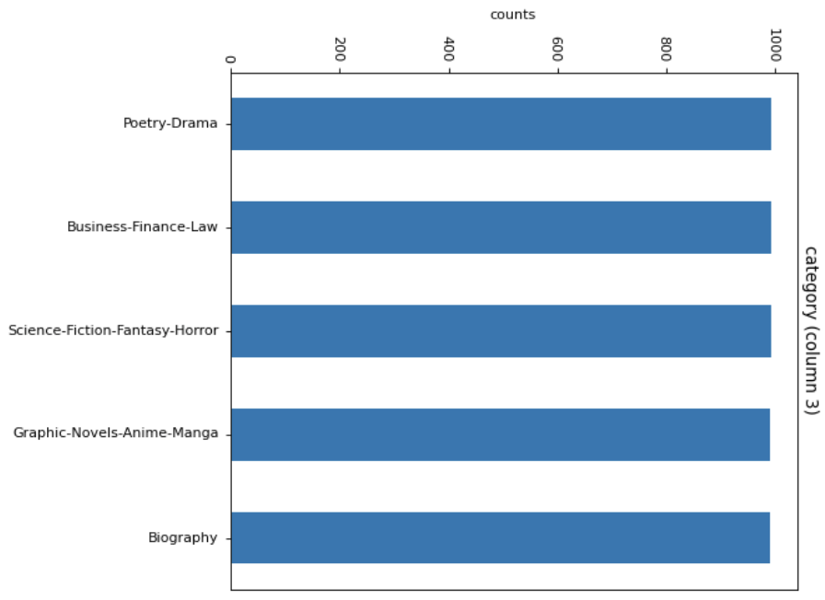
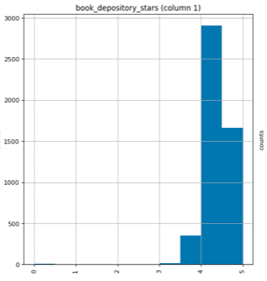



Dataset Processing
Genre filtered down to 5 categories for computational efficiency
Images resized to 128x128 pixels to ensure image consistency
New dataset of grayscale images produced to explore colorspace effects
Ratings are unbalanced

Slide 6
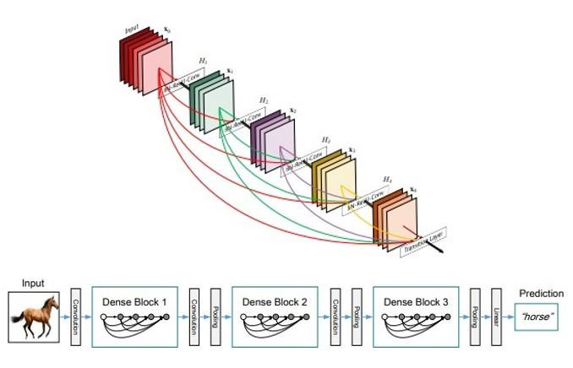
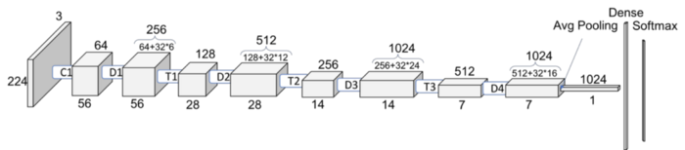
Classification method
DenseNet-121 CNN
Optimization: Adam
Epochs: 11
Learning Rate: 0.1
Loss Function: Negative Log Likelihood
Notes:
These algorithms have convolution layers, pooling layers and fully-connected layers. Traditional CNN’s have X layers with X connections, one between each layer and its subsequent layer, while DenseNet-121 has X(X+1)/2 connections. By using DenseNets we can ensure maximum information (and gradient) flow. To do it, we simply connect every layer directly with each other. These extra connections give us a number of advantages:
Alleviation of the vanishing gradient problem
Strengthened feature propagation
Encourage feature reuse and reduce the number of parameters
Each layer has direct access to the gradients from the loss function

Slide 7
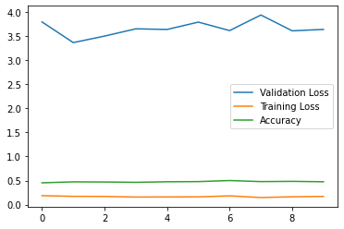
Results:
Genre classification on grayscale images
DenseNet-121 predicted 47% of test samples correctly on grayscale images
Notes:
Our model achieved an accuracy of 0.47 on the greyscale testing set with five genres. From the figure, it appears that the model is underfitting the data because the validation losses don’t converge to the training losses.

Slide 8
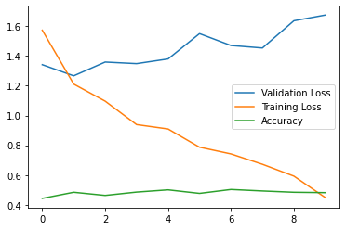
Results:
Genre classification on coloured images
DenseNet-121 predicted 48% of test samples correctly on grayscale images
Notes:
On the RGB training and test sets, the model performed similarly, achieving an accuracy of 0.48, but with lower training losses than the greyscale

Slide 9
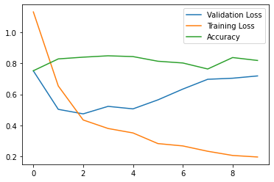
Results:
Classification on ratings
DenseNet-121 predicted 81% of test samples correctly
Notes:
Since the processing of images as RGB or grayscale did not greatly improve accuracy, we chose to use grayscale posters to predict book ratings. The results for the training and testing of the ratings is shown in the figure. The model attained an accuracy of 0.81 on predicting the rating of a book.

Slide 10
Conclusion
Future Work:
More computational resources to train and test on more images practically
Use more balanced dataset for ratings
Other preprocessing techniques such as HSV transformation, thresholding, etc.
Increasing network and data size
Use supplemental information such as textual features alongside book covers
The model performed best on rating predictions
Comparative accuracies between colored and grayscale images when predicting the genre of a book

Slide 11
Applications
Tailor customer’s shopping experiences
Detecting inappropriate or adult content from children websites
Hate speech in memes if we can supplement image classification with text feature recognition
Marketing, advertising, and design applications

Slide 12
References
Arūnas Gudinavičius, Andrius Šuminas. (2018) Choosing a book by its cover: analysis of a reader’s choice. Emerald. ISSN: 0022-0418
Shoko Nakahata, Emiko Sakamoto, Akiho Oda, Noriko Kobata, Sho Sato. (2016). Effects of color of book cover and typeface of title and author name on gaze duration and choice behavior for books: Evidence from an eye‐tracking experiment. Proceedings of the Association for Information Science and Technology. Vol 53.
Gao Huang, Zhuang Liu, Laurens van der Maaten, Kilian Q. Weinberger. (2018). arXiv: 1608.06993
Luke Anicin. (2019). Book Covers Dataset. Kaggle.
Gabriel Barney (barneyga) and Kris Kaya (kkaya23). (2019). Predicting Genre from Movie Posters. Stanford.
Diederik P. Kingma, Jimmy Ba. (2014). Adam: A Method for Stochastic Optimization. arXiv:1412.6980
Hoang, Q. (2018). Predicting movie genres based on plot summaries. arXiv preprint arXiv:1801.04813.
Eric Makita and Artem Lenskiy. A multinomial probabilistic model for movie genre predictions. arXiv preprint arXiv:1603.07849, 2016.
L. A. Gatys, A. S. Ecker, and M. Bethge, “A neural algorithm of artistic style,” arXiv preprint arXiv:1508.06576, 2015.
Zujovic, Jana, et al. ”Classifying paintings by artistic genre: An analysis of features & classifiers.” Multimedia Signal Processing, 2009. MMSP’09. IEEE International Workshop on. IEEE, 2009.
Zhou, Yao & z, l & Yi, Zhang. (2019). Predicting movie box-office revenues using deep neural networks. Neural Computing and Applications. 31. 10.1007/s00521-017-3162-x.

